Slide 1
Machine Learning Final Project Taiwan Futures Prediction
0516094 張維哲
0516041 蘇裕盛
0516321 劉庭銘
0516077 林向陽
0516035 楊寧之
Team 14
2019/01/08

Slide 2
1
Motivation
2
Data Crawling And Visualization
OUTLINE
3
Learning models
4
Conclusion

Slide 3
Motivation
/01

Slide 4
Motivation
What is futures?

Slide 5
Motivation
TWSE
(台灣加權指數)
TXF
(台灣指數期貨)

Slide 6
Motivation
Why choose futures?

Slide 7
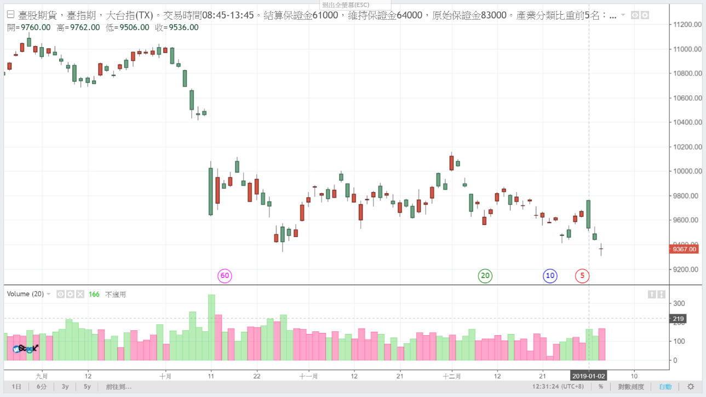
Motivation

Slide 8
Data Crawling And Visualization
/02

Slide 9
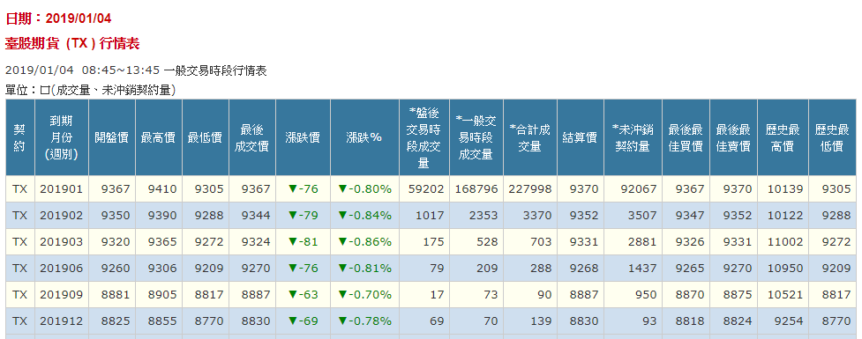
Data Crawling And Visualization
(http://www.taifex.com.tw/cht/3/futDailyMarketReport)

Slide 10
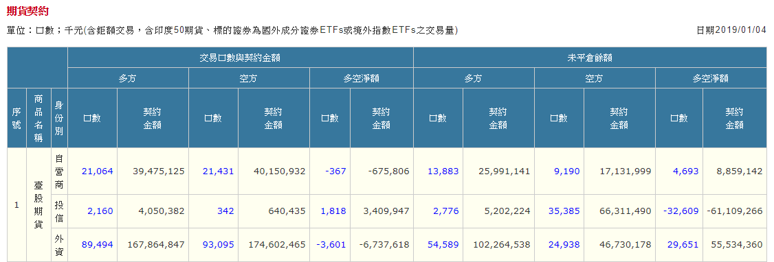
Data Crawling And Visualization
(http://www.taifex.com.tw/cht/3/futContractsDate)

Slide 11
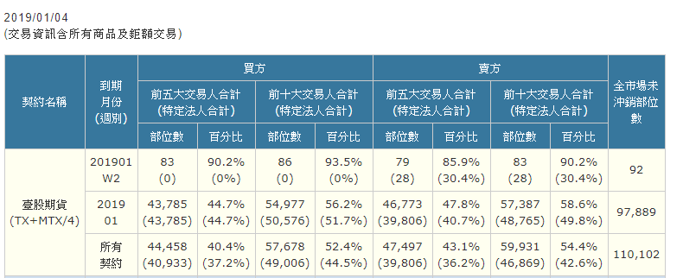
Data Crawling And Visualization
(http://www.taifex.com.tw/cht/3/largeTraderFutQry)

Slide 12
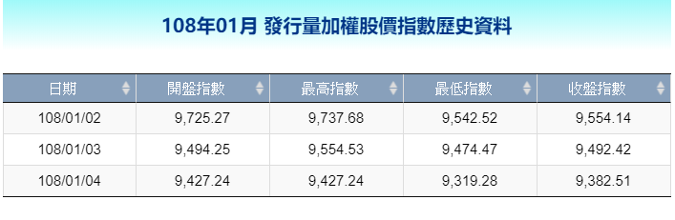
Data Crawling And Visualization
(http://www.twse.com.tw/zh/page/trading/indices/MI_5MINS_HIST.html)

Slide 13
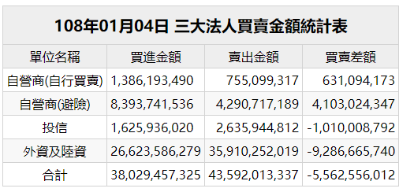
Data Crawling And Visualization
(http://www.twse.com.tw/fund/BFI82U?response=html&dayDate=20190104)

Slide 14

Data Crawling And Visualization

Slide 15
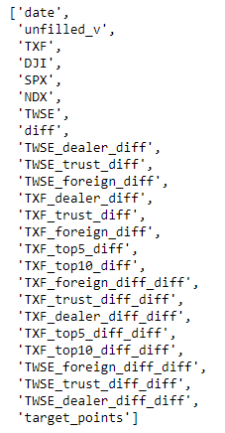
Data Crawling And Visualization

Slide 16
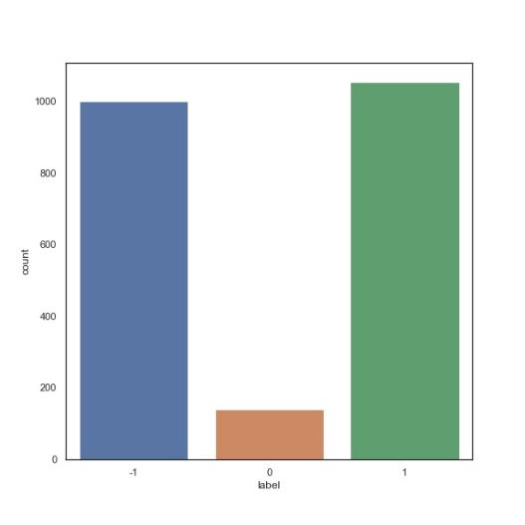
Data Crawling And Visualization
If target_points >= 5 : label = 1
If target_points <= -5 : label = -1
Else : label = 0

Slide 17
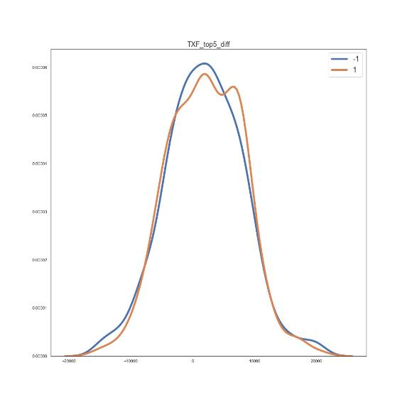
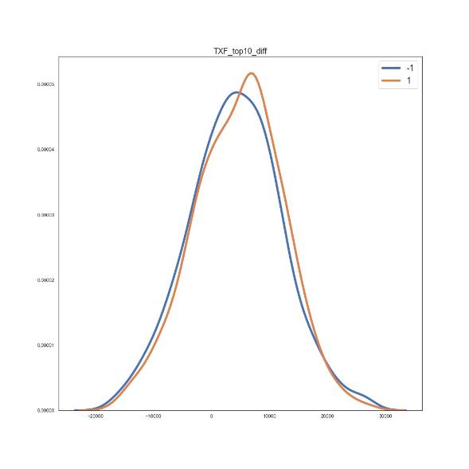
Data Crawling And Visualization

Slide 18
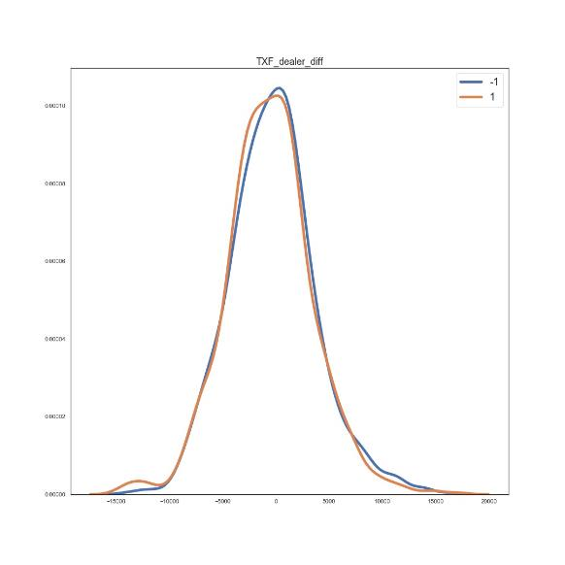
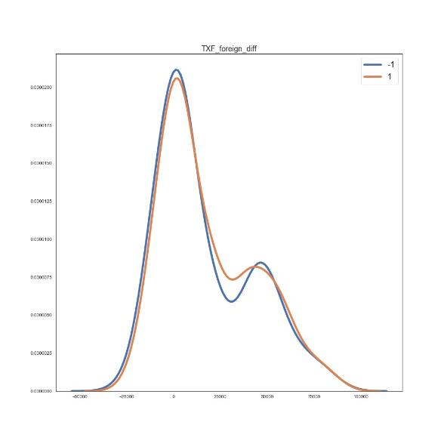
Data Crawling And Visualization

Slide 19
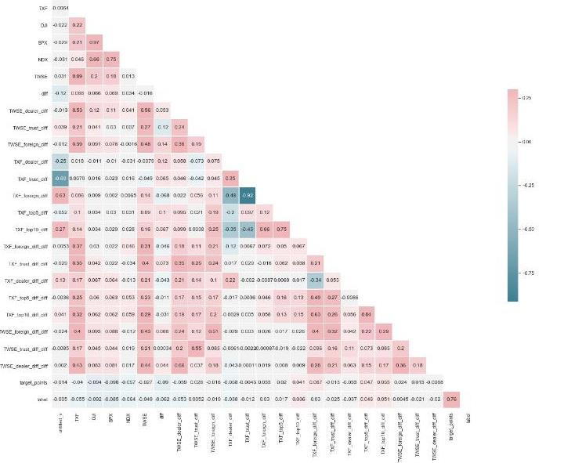
Data Crawling And Visualization

Slide 20
Learning models
/03

Slide 21
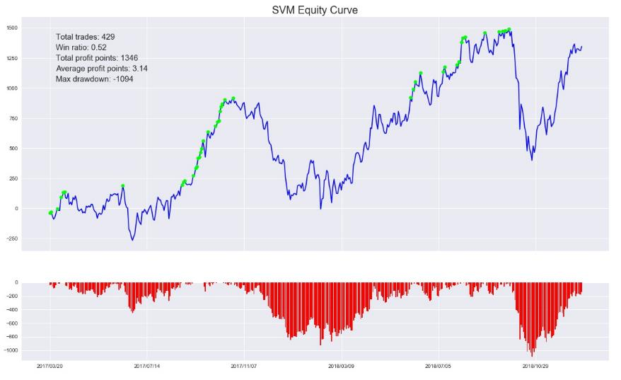
Model – SVM
training date:2010/01/05 ~ 2017/03/17
testing date: 2017/03/20 ~ 2018/12/20
training set score: 0.835
testing set score: 0.501

Slide 22
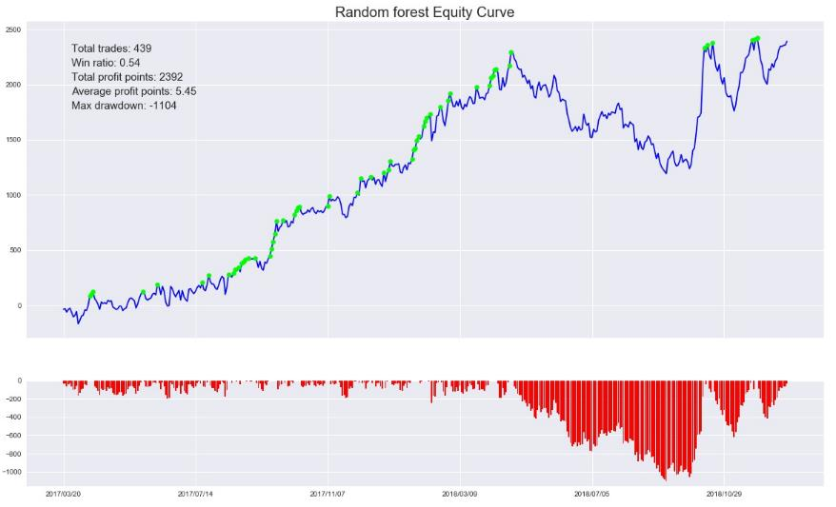
Model – Random Forest
training date:2010/01/05 ~ 2017/03/17
testing date: 2017/03/20 ~ 2018/12/20
training set score: 0.724
testing set score: 0.524

Slide 23
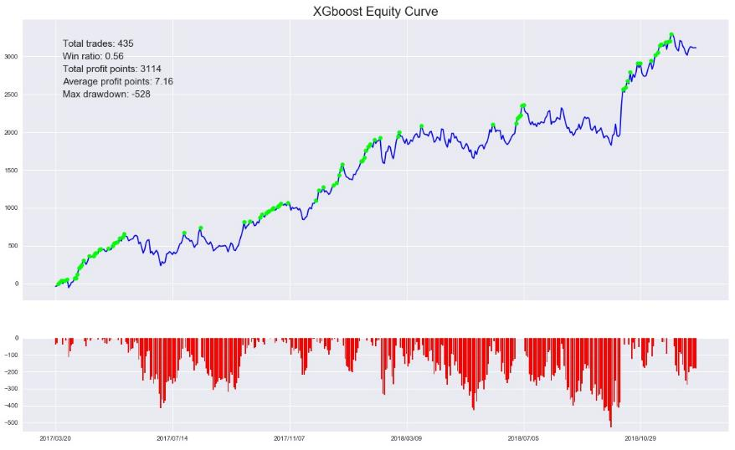
Model – XGBoost
training date:2010/01/05 ~ 2017/03/17
testing date: 2017/03/20 ~ 2018/12/20
training set score: 0.718
testing set score: 0.542

Slide 24
Conclusion
/04

Slide 25

Conclusion
XGBoost result shows good robustness.
Can create more label
Introducing investment strategy(e.g. max loss)

Slide 26
Work Distribution Table
Member | Contribution
0516094 張維哲 | Data crawling、Visualization、XGboost、Presentation、Report
0516321 劉庭銘 | Random forest
0516041 蘇裕盛 | SVM
0516077 林向陽 | Report

Slide 27
Thanks.

